Slide 1

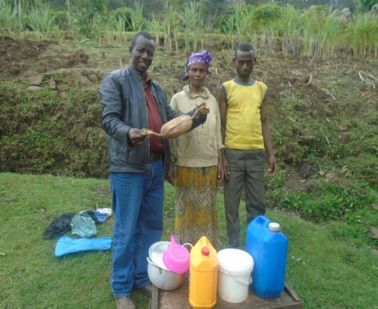
COLLEGE OF AGRICULTURAL SCIENCES
DEPARTMENT OF ANIMAL SCIENCE
ASSESSMENT OF DAIRY CATTLE MANAGEMENT PRACTICES, AND
THE HANDLING, PROCESSING, AND
MARKETING OF DAIRY PRODUCTS IN GERESE WOREDA, GAMO ETHIOPIA
MSc. THESIS
BY: HABTAMU GAMO
      ADVSOR :- Dr. KETEMA WORKU
      CO-ADVSOR:-PROF. YISEHAK KECHERO
      OCTOBER, 2023
      ARBA MINCH, ETHIOPIA

Slide 2
OUTLINES
INTRODUCTION
MATERIALS AND METHODS
3. RESULTS AND DISCUSIONS
4. CONCLUSSION AND RECOMMENDATIONS

Slide 3
1. INTRODUCTION
1.1. Background of the study
Ethiopia has the most livestock in Africa, with 65 million cattle, 40 million sheep, 51 million goats, 8 million camels, and 49 million chickens and based breed, an exotic breeds, cross breed and local make up 0.3%, 1.9%, and 97.8% of cattle, respectively (CSA, 2020).
The estimate of total cow milk production for the rural sedentary areas of the country is about 3.32 billion liters (Gobena & Hundie, 2020).
Despite its large size, Ethiopia's livestock sub-sector is less productive in general, and its direct contribution to the national economy is modest in comparison to its potential.

Slide 4
1.2. Statement of the Problem
Dairy cattle production systems are an important part of livestock keeping in many parts of the world, it provides milk, meat, manure, and other products that are essential for rural and urban communities.
However, dairy development has been hampered by a number of constraints, including genotype, feed resources, access to services, and marketing (Herrero et al., 2013).

Slide 5
In order to mitigate these challenges and advocate the improve dairy production and marketing systems, it is important to study the existing trends of production systems, milk handling, processing, utilization, and marketing (Lemma et al., 2018).
This will help to identify major constraints and devise strategies to alleviate the problem.
In the Gerese Woreda of Ethiopia, dairy management systems, byproduct processing, handling, utilization and marketing have not been studied.

Slide 6
This is a major gap in knowledge, as the area has the potential to be a major dairy producer.
Data on milk processing, handling, utilization, and marketing in the area is of paramount importance.
This data will help to improve the quality of traditional milk products and make them more marketable.
It will also help to identify and address constraints that are limiting productivity.

Slide 7
1.3. Objective
1.3.1. General objective
To assess the dairy cattle management system, dairy byproduct processing, utilization, and marketing in the two agro-ecological zones of Gerese woreda Gamo zone, south Ethiopia.
1.3.2. Specific objectives
To identify the dairy cattle production system in the study area
To explore the handling and processing ways of milk in study area
To assess the dairy product utilization and marketing in a study area
To assess the opportunities and constraints of dairy production, and product utilization in the study area.

Slide 8
3. MATERIALS AND METHODS
3.1. Description of the Study Area
The study was conducted in Gamo Zone Gerese Woreda of the Southern Nation’s Nationalities and Peoples Regional State of Ethiopia.
It is located 505 km from Addis Ababa and 275 km south-west of Hawassa.
The Gamo Zone consists of 14 rural districts and four reform towns.
The study was conducted in Gerese woreda in two agro-ecological zones: such as from lowland (Dembille Otha and Dembille kebeles) and from midland (Zaze, Pishito, and Dhenkele kebeles) in Figure 1 below.

Slide 9
Figure 1: Map of the study area

Slide 10
3.2. Sample Size and Sampling Techniques
The sample size for the study was determined using the formula of Cochran (1963). no = z²pq/e²
where: no is the sample size, z is the normal curve that cuts off an area α at the tails, p is the estimated proportion of an attribute that is present in the population, q is 1-p and e is the desired level of precision
The desired confidence level was 95%, the level of precision was 5%, and the estimated proportion of dairy cattle owners in the population was 9% then the sample size was totally, 126 households.
The households were selected using a purposive sampling technique, based on their owner of dairy cattle.

Slide 11
3.3. Sources of Data and Data Collection
Both primary and secondary data collection methods were used to achieve the objectives of this study.
Primary data was collected from 126 households who raised dairy cattle using structured questionnaire and household observation.
In addition, informal surveys in the form of group discussions were conducted with kebele administrators and extension workers to acquire relevant information.

Slide 12
3.6. Data Analysis
Quantitative and qualitative data analyses were done for the data collected.
Simple descriptive statistics such as frequency, percentage, and mean were used to analyze the data using SPSS for windows version 20 (SPSS, 2011).
The results were presented in the form of tables.
Also the collected data was analyzed using the General Linear Model (GLM) by using SPSS software to explain the difference between the two agro-ecological zones in production system, milk handling, processing, and marketing. Y_{ij} = μ + A_{i} + ε_{i}
Where: Y_{ij} is the response variable, μ is the overall mean, A_{i} is the fixed effect of the i^{th} agro-ecological zone and ε_{i} is the random error.

Slide 13
4. RESULTS AND DISCUSSIONS
4.1. Socio-economic Characteristics of Respondents
Based on these socioeconomic factors, about 118 (93.65%) and 8 (6.34%) male and female respectively, households.
The highest and minimum ages in the research region were 23 and 63, respectively, with a mean age of 40.476 ± 6.734 for the entire population.
The results of the current study are consistent with those of Ayalew and Abatenhe (2018), who said that in Southern Ethiopia, 95% of the respondents who were questioned were men, with the remaining 5% being female household members.

Slide 14
The average mean family size of the study households was 5.714±1.584, while, the midland and midland were 6.068 ± 1.652 and 5.226 ±1.353, respectively.
All respondents were married, 100% of them having this status.
The study area's respondents had an average landholding capacity was 1.706 ± 0.658.
In Midland and lowland respondents' average land holdings were 1.58 ± 0.619 and 1.867 ± 0.680, respectively.
An overall religious affiliations were orthodox and protestant, with 45 (35.71%) and 81 (64.28%), respectively.

Slide 15
Concerning the overall educational background of the interviewed farmers, majority 61 (48.4%) were in grades 5-8 junior secondary school and followed 35 (27.8%) were in grades 1–4 primary school, in the study area.
The study was in line with Zereu & Lijalem (2016), who reported that the majority (76.3%) of the respondents were literate; the rest (23.7%) were illiterate in the Wolaita zone in southern, Ethiopia.
The main occupations of the respondents were 85 (67.46%), and followed household wife 25 (19.8%) in the study area.

Slide 16
4.2. Dairy Cattle Compositions
Cattle | Local | % | Cross | % | Total | %
Cows | 327 | 44.12 | 97 | 42.92 | 424 | 43.84
Calves | 171 | 23.07 | 14 | 6.19 | 185 | 19.13
Heifers | 58 | 7.82 | 68 | 30.08 | 126 | 13.02
Bulls & oxen | 185 | 24.96 | 47 | 20.79 | 232 | 23.99
Overall | 741 | 76.62 | 226 | 23.38 | 967 | 100

Slide 17
The average number of local and cross breed cattle per family in the study area.
Cattle | Local | Cross | Total | Mean ±SD (n =126)
 |  |  |  | Local | Cross | Overall
Cows | 327 | 97 | 424 | 2.67±2.036 | 0.77±1.104 | 3.36
Calves | 171 | 14 | 185 | 1.36±1.054 | 0.11±0.424 | 1.46
Heifers | 58 | 68 | 126 | 0.46±0.665 | 0.54±0.882 | 1.00
Bulls & oxen | 185 | 47 | 232 | 1.47±0.787 | 0.37±0.936 | 1.84
Overall | 741 | 226 | 967 | 5.88 | 1.79 | 7.67

Slide 18
4.4. Milk Production
The mixed production system was the main production type, about 126 (100%) in the study area.
About 126 people (100%) was got their only cow milk from home production.
Current study not line with the CSA (2014/15), cattle account for the majority (81.2%) of the nation's yearly milk production, followed by goats (7.9%), camels (6.3%), and sheep (4.6%).
The current finding is also in line with the finding of Kebede (2020), who reported that in Kaffa and Sheka Zones, Southern Ethiopia, the major production systems were mixed crop livestock production systems in which cereal crops predominantly produced.

Slide 19
4.5. Milking practices
The calf suckling was the sole technique of milking about 93 (73.8%) and washing teat and calf suckling were the second techniques of 22 (17.46 in the study area.
A calf suckling, and both washing teat and calf suckling techniques were practiced, about 43 (58.90%), and 19 (26.02%), respectively, in midland while, about 50 (68.49%), and 3 (5.66%), respectively, of respondents used that type of milking technique.
The funding was in line with Nigus et al. (2017), who reported that hand milking was the sole milking method practiced and calves were allowed to suckle their dams before and after milking.

Slide 20
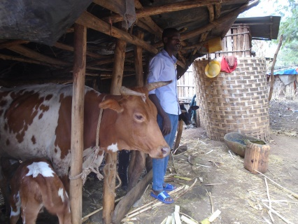

Slide 21
The overall frequency of milking was once a day 9(7.14%) and twice a day 117(92.85%).
About 120 (95.23%) of respondents washed their hands before milking, and the remaining 6 (4.76%) did not wash their hands before milking in the study area.
This result was not in line with Gemechu and Amene (2017), who indicated that 95.6% of respondents wash their hands before milking.
The study revealed by Maru et al. (2023) in Eastern Ethiopia disagreed with the present result: only 52.5% of respondents wash their hands before milking.

Slide 22
4.6. Cleaning and Smoking practice of Milk Handling Equipment
Plastic buckets and nickel containers made up about 107 (84.92%) and 19 (15.07%) respectively, were the milking equipment.
The current study comparable to the Gezu and Kebede (2015) findings, which showed that gourd, plastic, and stainless steel were used as milking tools in the Dangila zone in the western Amhara region.
Utensils used for storage were clay pots or Ensira 37 (29.36%), Kele 76, (60.31%), and any other 13 (10.31%) in the study area.
In Midland, the milk utensils used for storage were clay pots, Ensira 36 (49.31%), Kele 24 (32.87%), and any other 13 (17.80%) in the study area.
In lowland, the milk utensils used for storage were clay pots, Ensira 1 (1.88%), and Kele 52 (98.12%) in the study area.

Slide 23
The majority of respondents 68(53.96%)) said it was done for all purposes by using smoking milk handling equipment in the study.
The types of plants used for cleaning milking equipment were kosorote (Oocimum haardiense), tej sar (Cymbopogan martini), tenadem (Ruta chalepensis), and woyira (Olea africana) about 61 (48.41%), 47 (37.30%), 11 (8.73%), and 6 (4.76%) respectively.
There was a significant difference (p < 0.05) in the type of plants used for cleaning milking equipment in the study areas.

Slide 24
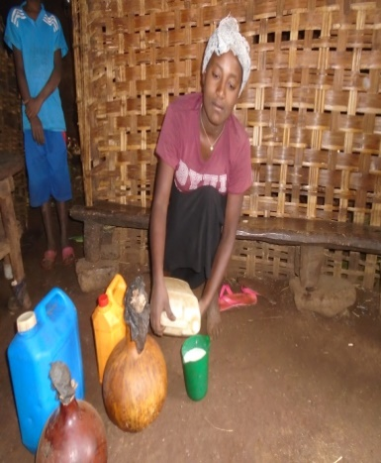
Milk Handling Equipment

Slide 25
4.7. Milk Processing Practices
Table 8: The utilized milk products from milk in the study area.
Variables |  |  | Agro-ecology
 |  |  | Midland | Lowland | Overall | P-value
What are the utilized milk products from milk in your house |  | Raw milk | 6(8.21%) | 3(5.66%) | 9(7.14%)
 |  | Butter | 13(17.80%) | 20(37.73%) | 33(26.19%)
 |  | Ergo | 2(2.73%) | 26(49.05%) | 28(22.22%)
 |  | Butter milk | 47(64.38%) | 2(3.77%) | 49(38.88%)
 |  | All | 5(6.84%) | 2(3.77%) | 7(5.55%)
Total |  |  | 73(100%) | 53(100%) | 126(100%) | <0.001
What are reasons for milk processing | To increase the shelf life of the product |  | 64(87.67%) | 39(73.58%) | 103((81.74%)
 | To get diversified products |  | 7(9.58%) | 14(26.41%) | 21(16.66%)
 | Both |  | 2(2.73%) | 0(0%) | 2(1.58%)
Total |  |  | 73(100%) | 53(100%) | 126(100%) | 0.025

Slide 26
Table 9: The equipment for milk churning, frequency of churning
Variables |  | Midland | Lowland | Overall | P-value
What is the equipment for milk churning? | Clay pot | 54(73.97%) | 33(62.26%) | 87(69.04%)
 | Gourd | 19(26.02%) | 20(37.73%) | 39(30.95%)
Total |  | 73(100%) | 53(100%) | 126(100%) | 0.163
Frequency of churning? | Once a week | 59(80.82%) | 53(100%) | 112(88.88%)
 | Once in a month | 10(13.69%) | 0% | 10(7.93%)
 | Once in two months | 3(4.10%) | 0% | 3(2.38%)
 | Once in a 3 months | 1(1.36%) | 0% | 1(0.79%)
Total |  | 73(100%) | 53(100%) | 126(100%) | 0.002

Slide 27
The current study, in line with the results of Tadesse and Shelima (2015), reported that 85.5% of gourds were used in Bahir Dar Zuria and Mecha districts.
Also, this result agreed with the result reported by Melku (2016) 73% and 27% of respondents used gourds and clay pots, respectively, in rural areas of the West Gojjam Zone.
There was a significant difference (p < 0.05) in the frequency of churning, but there was no significant difference (p > 0.05) in the equipment for milk churning or the use of buttermilk in the study area.

Slide 28
4.9. Cheese and Ghee Making Practice
Table 10: Cheese and ghee making, and butter handling equipment’s in the study area.
Variables |  | Agro-ecology |  | Total | P-value
 |  | Midland | Lowland
Do you process cheese from butter milk or Arera? | Yes | 16(21.91%) | 32(60.37%) | 48(38.09%)
 | No | 57(78.08%) | 21(39.62%) | 78(61.91)
Total |  | 73(100%) | 53(100%) | 126(100%) | <0.001
Do you process butter into ghee or nitir qibe | Yes | 21(28.76%) | 32(60.37%) | 53(42.06%)
 | No | 52(71.24%) | 21(39.62%) | 73(57.93%)
Total |  | 73(100%) | 53(100%) | 126(100%) | <0.001
What is the equipment for ghee handling | Gourd | 5(6.84%) | 21(39.62%) | 26(20.63%)
 | plastic container | 66(90.41%) | 59(9.43%) | 71(56.34%)
 | Stainless steel | 2(2.73%) | 27(50.94%) | 29(23.01%)
Total |  | 73(100%) | 53(100%) | 126(100%) | <0.001

Slide 29
Variables |  |  | Agro-ecology |  | Total | P-value
 |  |  | Midland | Lowland
Frequency of ghee making | Two times a week |  | 0(00%) | 27(50.94%) | 27(21.42%)
 | Once in a week |  | 17(23.28%) | 26(49.05%) | 43(34.12%)
 | Once in two weeks |  | 9(12.32%) | 0(0%) | 9(7.14%)
 | not making |  | 47(64.38%) | 0(0%) | 47(37.30%)
Total |  |  | 73(100%) | 53(100%) | 126(100%) | <0.001
What is the equipment for butter handling |  | Gourd | 3(4.10%) | 19(35.84%) | 22(17.46%)
 |  | Plastic container | 69(94.52%) | 7(13.20%) | 76(60.31%)
 |  | Stainless steel | 1(1.36%) | 27(50.94%) | 28(22.22%)
Total |  |  | 73(100%) | 53(100%) | 126(100%) | 0.118

Slide 30
4.6. Milk and Milk Products Marketing
Agro-ecology |  | Milk produced per day | price of fresh milk per liter | price of butter milk per litter | price of butter per kg | price of cottage cheese
Midland | Mean ±SD | 2.51±1.029 | 66.03±3.53 | 25.23±5.007 | 598.22±44.514 | 47.05±13.145
Lowland | Mean ±SD | 1.96±1.037 | 64.06±7.599 | 28.87±7.38 | 655.09±73.97 | 69.34±21.35
Total | Mean ±SD | 2.28±1.063 | 65.2±48.474 | 26.76±6.352 | 622.14±64.901 | 56.43±20.277
P- value |  | 0.004 | 0.823 | <0.001 | <0.001 | <0.001

Slide 31
Table 11: Means of transportation to market, milk marketing places and marketing problems in the study area.
Variables |  |  |  |  | Agro-ecology
 |  |  |  |  | Midland |  | Lowland |  |  | Overall | P-value
Means of transportation to market |  | On foot |  |  | 61(83.56%) |  | 24(45.28%) |  |  | 85(67.46%)
 |  | Bajaj |  |  | 12(16.43%) |  | 29(54.71%) |  |  | 41(32.53%)
Total |  |  |  |  | 73(100%) |  | 53 (100%) |  |  | 126(100%) | <0.001
Milk marketing places | Local market |  |  |  | 54(73.97%) |  | 53(100%) |  |  | 107(84.92%)
 | Neighbors consumers/home |  |  |  | 18((24.65%) |  | 0(0%) |  |  | 18(14.28%)
 | Milk cooperatives |  |  |  | 1(1.37%) |  | 0(0%) |  |  | 1(0.79%)
Total |  |  |  |  | 73(100%) |  | 53(100%) |  |  | 126(100%0 | <0.001
Milk marketing problem are? | Scarcity of milk |  |  | 71(97.26%) |  |  |  | 53(100%) | 124(98.41%)
 | Lack of market |  |  | 2(2.73%) |  |  |  | 0(0%) | 2(1.58%)
Total |  |  | 73(100%) |  |  | 53(100%) |  |  | 126(100%) |  | 0.228

Slide 32
4.7. Dairy Cattle Management Practices
4.7.1. Feed Resources, Feeding and watering
Table 13: The feed and water sources for dairy cattle in the study area.
Variables |  | Agro-ecology |  | Overall | P-value
 |  | Midland | Lowland
What are the feed sources for dairy cattle? | Communal grazing | 42(57.53%) | 33(62.26%) | 75(59.52%)
 | Crop field weeds & green fodder | 13(17.80%) | 19(35.84%) | 32(25.39%)
 | Crop residues | 2(2.73%) | 0(0%) | 2(1.58%)
 | All | 16(21.91%) | 1(1.88%) | 17(13.49%)
Total |  | 73(100%) | 53(100%) | 126(100%) | 0.010

Slide 33
Table 13: The water sources and its distance for dairy cattle in the study area.
Variables |  |  | Agro-ecology |  | Overall | P-value
 |  |  | Midland | Lowland
Total |  |  | 73(100%) | 53(100%) | 126(100%) | 0.010
What are the Sources of water for dairy cattle? | River or dam |  | 49(67.12%) | 52(98.11%) | 101(80.15%)
 | Wells |  | 3(4.10%) | 0(0%) | 3(2.38%)
 | Bore holes |  | 1(1.36%) | 0(0%) | 1(0.79%)
 | Springs |  | 20(27.39%) | 1(1.88%) | 21(16.66%)
Total |  |  | 73(100%) | 53(100%) | 126(100%) | <0.001
At what Distance of water available? |  | 500m | 31(42.46%) | 22(41.50%) | 53(42.06%)
 |  | 1-2km | 42(57.53%) | 31(58.50%) | 73(57.93%)
Total |  |  | 73(100%0 | 53(100%) | 126(100%) | 0.915

Slide 34
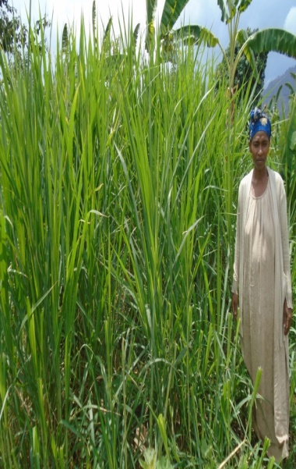
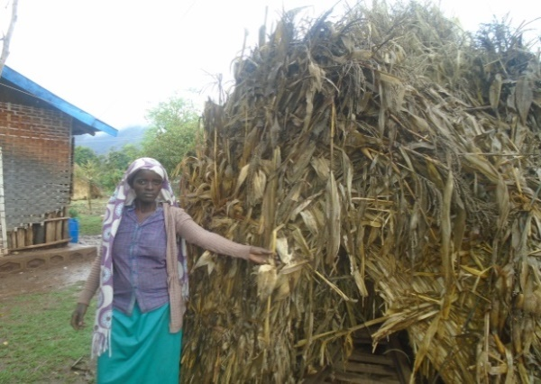
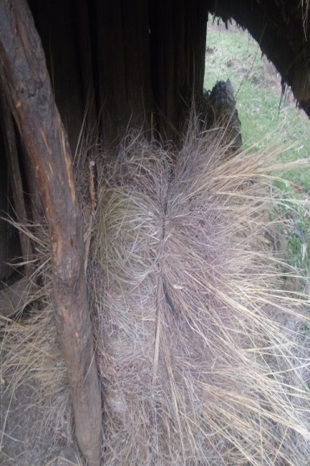
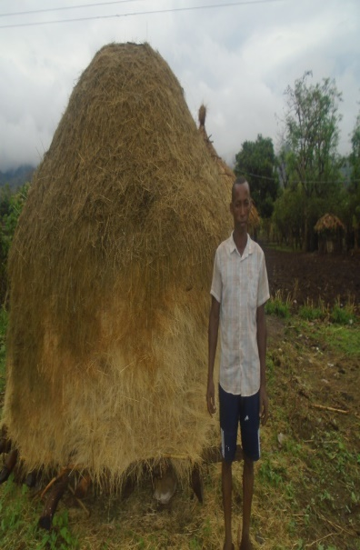
The feed sources for dairy cattle in the study area.

Slide 35
This result is in line with the findings of Chufa et al. (2022) who reported that natural pasture, hay, crop residues, and non-conventional feedstuffs (local brewery by-products) are major feeds in Bahir Dar Zuria and Mecha woredas of the Amhara Regional State.
The current study is similar to Sintayehu et al. (2008) report in Shashemene and Dilla areas; in Adigrat town, dairy farmers have no access to grazing land.

Slide 36
4.7.2. Supplementary Feeding
 |  |  | Agro-ecology
Variables |  |  | Midland | Lowland | Overall | P-value
Do you provide supplementary feed for your cattle |  | Yes | 46(63.01% | 34(64.15%) | 80(63.49%)
 |  | No | 27(36.98%) | 19(35.84%) | 46(36.50%)
Total |  |  | 73(100%) | 53(100%) | 126(100%) | 0.897
Source of supplementary feed? | Purchased from market |  | 13(17.80%) | 32(60.37%) | 45(35.71%)
 | From household |  | 36(49.31%) | 2(3.77%) | 38(30.155)
 | crop Harvest |  | 22(30.13%) | 19(35.84%) | 41(32.53%)
 | Harvested &purchased |  | 2(2.73%) | 0(0%) | 2(1.58%)
Total |  |  | 73(100%) | 53(100%) | 126(100%) | 0.006

Slide 37
4.7.3. Housing and Cleaning Practice
Table 17: Housing and cleaning practice in the study area.
Variables |  | Agro-ecology
 |  | Midland | Lowland | Overall | P-value
Type of barn | Confined house | 20(27.39%) | 21(39.62%) | 41(32.53%)
 | Separate house | 47(64.38%) | 32(60.37%) | 79(62.695)
 | Both | 6 (8.21%) | 0(0%) | 6(4.76%)
Total |  | 73(100%) | 53(100%) | 126(100%) | 0.038

Slide 38
4.13. Dairy cattle Breed and Breeding Practices
Table 15: Mating system and season, types of breeding bull and sources of AI services in the study area
Variables |  | Agro-ecology |  | Overall | P value
 |  | Midland | Lowland
The type of mating system | Natural | 19(26.02%) | 21(39.6%) | 40(31.74%)
 | AI | 1(1.36%) | 0(0%) | 1(0.79%)
 | Both | 53(72.60%) | 32(60.3%) | 85(67.46%)
Total |  | 73(100%) | 53(100%) | 126(100%) | 0.126
If natural breeding bulls are? | Any bull | 28(38.35%) | 6(11.32%) | 34(26.98%)
 | Superior bull | 45(61.64%) | 47(88.6%) | 92(73.01%)
Total |  | 73(100%) | 53(100%) | 126(100%) | 0.023

Slide 39
4.13. Dairy cattle Breed and Breeding Practices
Table 15: Mating system and season, types of breeding bull and sources of AI services in the study area
Variables |  | Agro-ecology |  | Overall | P value
 |  | Midland | Lowland
The mating season is? | Dry season | 4(5.47%) | 12(22.6%) | 16((12.67%)
 | Rainy season | 5(6.84%) | 32(60.3%) | 37(29.36%)
 | Both | 20(27.39%) | 4(7.54%) | 24(19.04%)
 | We did not know | 44(60.27%) | 5(9.43%) | 49(38.88%)
Total |  | 73(100%) | 53(100%) | 126(100%) | <0.001
The sources of AI are? | Government NGO | 33(45.20%) 0(0%) | 53(100%) 0(0%) | 86(68.25%) 0(0%)
 | Both | 40(54.79%) | 0(0%) | 40(31.74%
Total |  | 73(100%) | 53(100%) | 126(100%) | <0.001

Slide 40
4.14. Major Constraints of Milk Production
Table 16: Major constraints of milk production in the study area.
 | Agro-ecology
Variables | ML |  |  | LL |  |  | Overall
Shortage of feed | Sum | Index | Ran | Sum | Ind | Ra | Su | Ind | Ra
 | 398 | 0.254 | 2 | 257 | 0.237 | 1 | 655 | 0.247 | 1
Scarcity of land | 405 | 0.258 | 1 | 241 | 0.222 | 3 | 646 | 0.244 | 2
Disease | 267 | 0.170 | 3 | 167 | 0.154 | 4 | 434 | 0.164 | 4
Accessibility to marketing place and limitation of market information | 133 | 0.084 | 5 | 144 | 0.133 | 5 | 277 | 0.104 | 5

Slide 41
Table 16: Major constraints of milk production in the study area.
 | Agro-ecology |  |  |  |  |  |  | Overall
Variables | ML Sum | Ind | Ran | LL Sum | Ind | Ran | Sum | Ind | Ran
Absence of improved breed and inadequate artificial insemination | 266 | 0.169 | 4 | 249 | 0.230 | 2 | 475 | 0.179 | 3
Inadequate infrastructure | 96 | 0.061 | 6 | 63 | 0.058 | 6 | 159 | 0.06 | 6
Total | 1565 1 1081 |  |  |  | 1 |  | 2646 | 1

Slide 42
The current finding similar to Weldegebriall (2015), study in agro pastoral community reported that shortage of feed and water were ranked 2nd and 3rd respectively specially during dry season, other constraint included high price of veterinary drugs, low genetic potential of zebu cattle, and lack of market for the animal specially during the rainy season when road to live stock market are not possible.
This is in line with the findings of Ayalew and Abatenhe,(2018), who reported that feed shortages were the most important constraint contributing to the low production and productivity of dairy cattle in different parts of Ethiopia.

Slide 43
5. CONCLUSIONS AND RECOMMENDATIONS
5.1. Conclusions
In the research area, the with a maximum age of 63 and a minimum age of 23, the average age was 40.476 ± 6.734.
This demonstrated that the family could supply the useful work needed for the upkeep, promotion, and management of dairy cattle production.
According to the respondents' overall average land holding capacity in the study area, which was 1.706 ± 0.658, there is not enough land for all agricultural operations.
The domestic consumption of milk, as well as all dairy cow-keeping goals such as domestic and local market sales, saving, and income diversification for their subsistence, are examples of the economic and social effects of keeping dairy cattle.

Slide 44
The majority of milk was churned once a week (80.88%), although it is recommended to churn milk just once every month, once every two months, and once every three months (7.93%, 2.38%, and 0.79%, respectively) to avoid milk becoming sour.
About 92.85% of respondents said their families regularly drank butter milk.
A majority of the remaining 61.93% of responders (or about 38.09%) were not producers of cheese.
The equipment used to prepare butter in the research area was primarily composed of gourds (17.46%), plastic containers (60.31%), and stainless steel (22.22%).

Slide 45
In terms of cleanliness and hygienic practices, the cow barn was cleaned daily, once per week, twice per week, and three times per week, for a total of 114 (90.47%), 5, 6, and 0.79 percent, respectively.
With index values ranging from 0.247, 0.244, and 0.164 from the first to the third rank, the overall major constraints on milk production were a lack of feed, a lack of available land, disease, accessibility to marketing locations, a lack of market information, the absence of improved breeds, inadequate artificial insemination, and inadequate infrastructure.

Slide 46
  5.2. Recommendations
Changing the attitude of the farmers through training and other mechanisms should be done in order to improve the handling practices of milk and milk products.
The main constraints on milk production in the study area were a lack of feed, a lack of land, and diseases.
As a result, stockholders like GO and NGO should provide better forage resources, animal feed conservation techniques, and disease treatment and prevention methods.
When their cows are in heat, some farmers will breed them with any bull in the herd that is available, as well as with neighbors, showing that they have not considered the bull's performance or characteristics, as well as the time of year when mating takes place.

Slide 47
THANK
YOU
!!!

